Slide 1
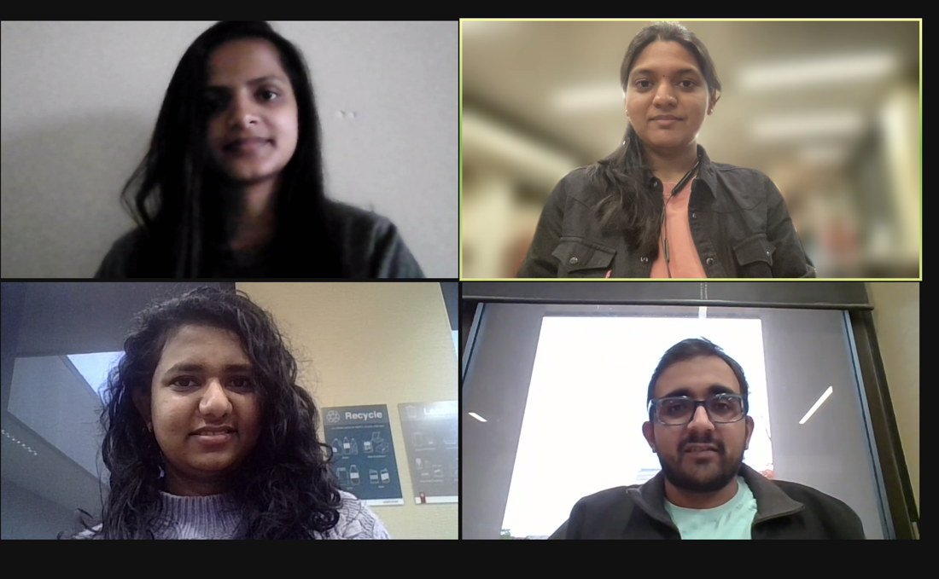
Cats vs Dogs Detector (CaDoD) - Phase 1
Group 19
Aishwarya Sinhasane, Himanshu Joshi
Sreelaxmi Chakkadath , Sumitha Vellinalur Thattai

Slide 2
Agenda
Agenda
Abstract
Exploratory Data Analysis
Data Description
Preprocessing
Baseline Model
Results and Discussion
Conclusion & Next Steps

Slide 3
Abstract
Abstract
Objective:
To classify images as either dogs or cats
Find where the cat/dog is in the image
Baseline Models:
Logistic Regression, AdaBoost, and Gradient Boost for classifying images
Linear Regression for finding the boundaries
Metrics Used For Model Evaluation:
Accuracy
F1 Score
Future Steps - To build a CNN model

Slide 4
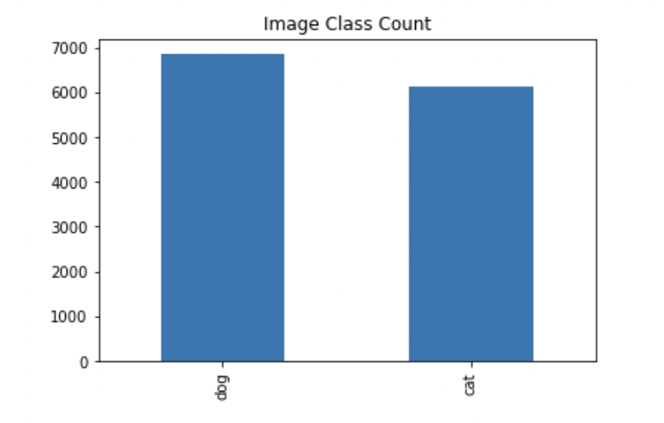
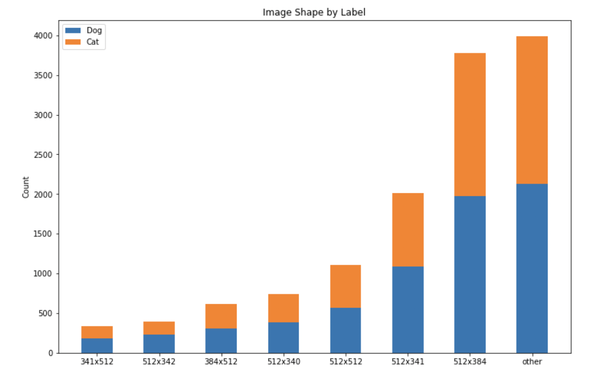
Exploratory Data Analysis – Data Description
Exploratory Data Analysis
Data used
cadod.csv
cadod.tar.gz
Data set has ~12k images (~6.8K cat and ~6.1K dog images)
20 features (15 numerical, 5 categorical)

Slide 5
Exploratory Data Analysis – Pre-processing
Exploratory Data Analysis
Rescaling
Resize all images to same size (128 X 128)
Data Augmentation
Increase the diversity of images available without collecting additional data
Enables model to learn generalized features instead of overfitting on the dataset
Augmentation used in our project:
Rotation
Zoom
Flip (Horizontal and Vertical)

Slide 6
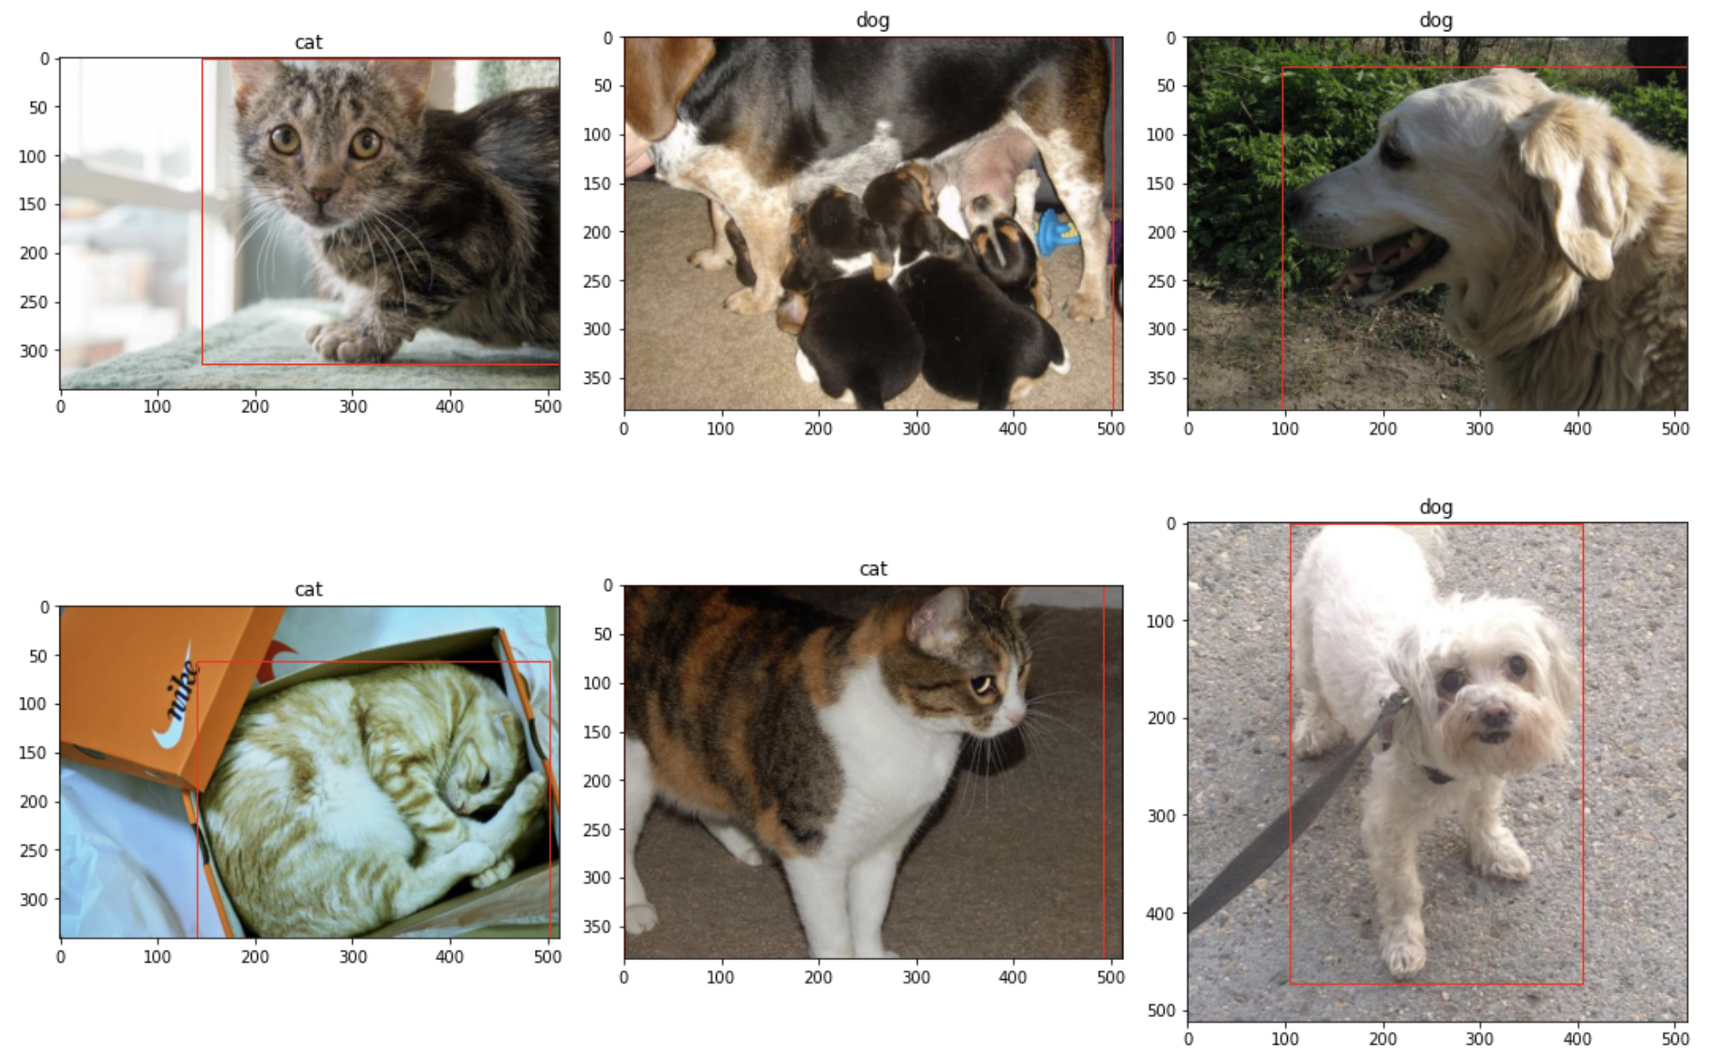
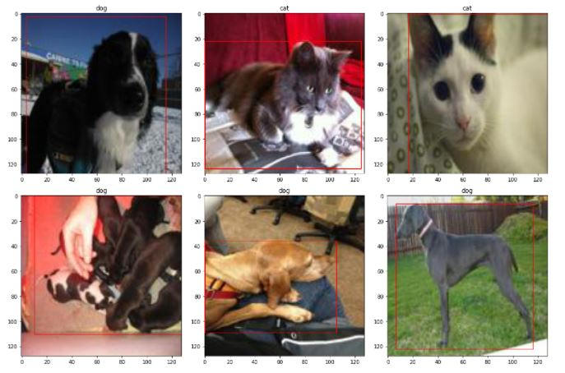
Pre-processing Step - Rescaling
Exploratory Data Analysis
Before Rescaling
After Rescaling

Slide 7
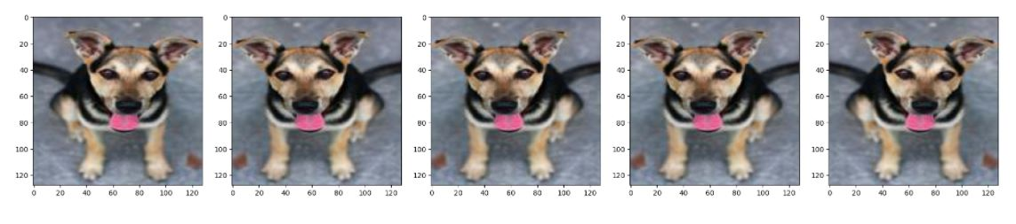
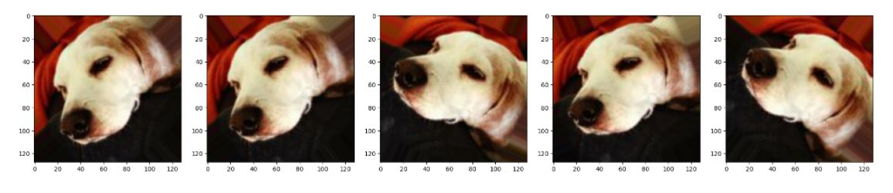
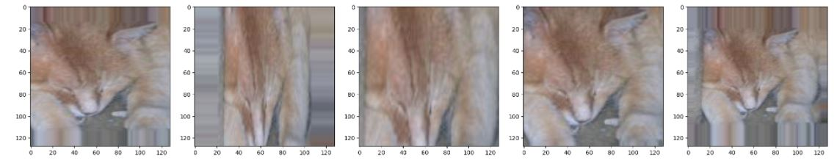
Pre-processing Step – Data Augmentation
Exploratory Data Analysis
Horizontal Flip
Rotations
Zoom
We are using this augmented data in our current model

Slide 8
Baseline Model
Baseline Model
Image Classification:
We trained our image data set and compared results from Logistic regression with Stochastic Gradient Descent, Adaboost, and Gradient boost
Gradient boosting yielded a very high train and test accuracy (and F1 score) among other models
This will be our baseline model moving forward
Gradient Boosting
It is an ensemble of decision trees (which are weak prediction models)
Image Boundary Detection:
Linear regression yielded a low MSE score, and hence will be used as our baseline model
Results in the next slide

Slide 9
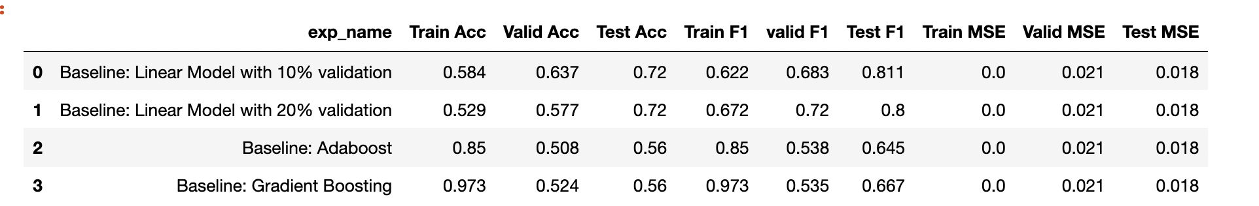
Results and Discussion
Results and Discussion
Image Classificatin
We ran SGD, Adaboost and Gradient boost in a small data set to narrow of model search space
From the above table, we see the Gradient boost has a better accuracy than Adaboost
We will use this model to train our entire data set
Results will be directional (and not very accurate) since it is based on only 2500 data points

Slide 10
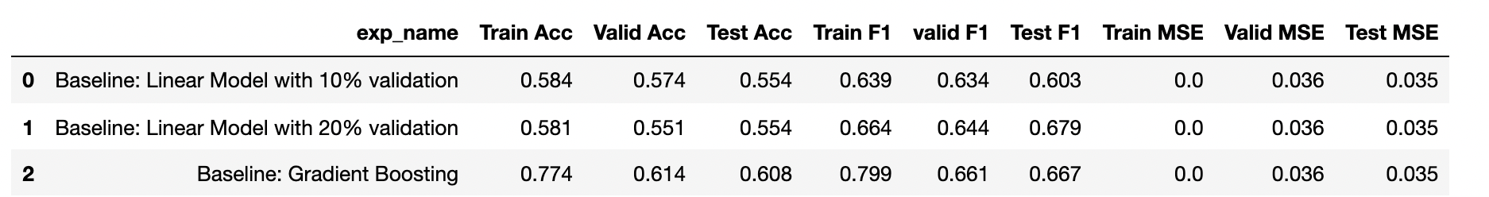
Results and Discussion
Results and Discussion
Image Classification
We see Gradient boosting performs well among other models
Baseline Model chosen – Gradient Boosting
Boundary Detection
Linear regression yields a MSE close to 0, hence will be used as a baseline model for box detection
Result based on entire data set

Slide 11
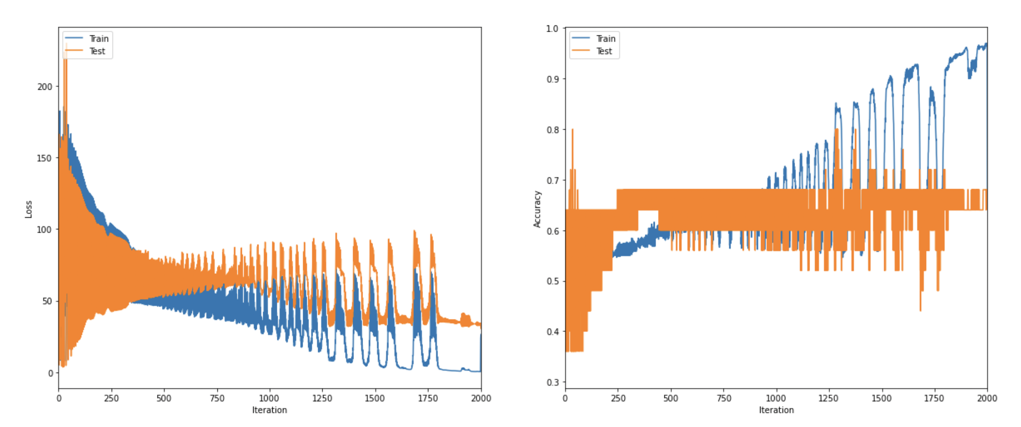
Homegrown Logistic Regression
Results and Discussion
Log Loss
Accuracy
Homegrown Logistic Regression
We have implemented a logistic regression from scratch
Implemented functions to find the accuracy and log loss
Complex function
We have defined a function which will combine the log loss of the logistic regression and MSE of the linear regression
Result based on 2K images

Slide 12
Conclusion & Next Steps
Next Steps
Conclusion
Accuracy of the logistic regression was less, so we improved it by using gradient boosting
There is still scope for improvement
Next Steps
Fine tune the hyperparameters using GridSearchCV/RandomSearchCV
Image boundary detection can be improved further by using Ridge or Lasso regression
Building a CNN model to improve accuracy of image detection
Perform a t-test to compare the baseline model with the improved model

